Slide 1
E-MEDIATION in Bulgaria
Eliza Nikolova
Professional Association of Mediators in Bulgaria

Slide 2
From 1969 (invention of the internet) until 1992
Deep silence in internet
Online commerce is forbidden
No spam
No internet violation of copyright law
No abuse
No identity theft
No consumer scams
No data collection
No disputes over domain names
May be some pornography
More then 25 years primitive social network and no commercial network, no transactions or any significant relations in Internet

Slide 3
In the world of ADR 1980-1995
“Conflict is a growing industry“
Fisher and Uri,
“Getting to Yes"(1981)
Increasing the use of ADR - advantages and disadvantages
No interest on the web.
The focus falls outside the online space.

Slide 4
1992 - 1995 Creating an Internet environment for disputes
Year 1994
Numerous cases of abuse
First domain names issues
1000 domain names in 1990, 20 million in 2000
Pornography
Underdeveloped social network and primitive trading network
First cases of spam

Slide 5
from
2000
More variety
More speed
More data collection (confidentiality challenges) - the data becomes valuable
Mobile phones and networks
More transactions
Online games
Labor force
Healthcare
Social network
Progress beyond e-commerce. The online world is expanding with the move of the physical world online.
Impact on:

Slide 6
What is ODR?
ONLINE DISPUTE RESOLUTION (ODR) is the use of information and communication technologies to help disputants find a solution to their problems.

Slide 7
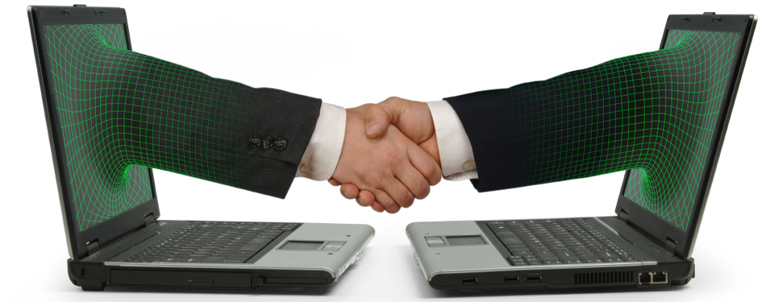
Benefits of ODR
Efficiency / Convenience
Cost savings
Satisfaction of the participants
Distance - to cool emotions
Synchronous and Asynchronous Interaction
Thinking before communication
Simultaneous connection
Archived communication
Automated procedures

Slide 8
The implementation of ODR includes the following stages
input of initial information,
launch of the procedure /thanks to the initiative of at least one party and the work of the technologies /,
gathering of information, evidence, etc.,
hearing if needed, conducting online discussions - audio and video,
developing an agreement.

Slide 9
E-mediation
the use of technology /computer, mobile device, telephone, etc. / and software support the mediator and the parties in the following actions:
organizing information,
sending automatic messages,
drafting the written communication,
blocking the rough language, video and conferencing, drafting the agreement, etc.
the software can monitor the meetings - start, duration, clarification of interests and priorities, etc. activities, depending on the development parameters.

Slide 10
New Court Room

Slide 11
Court
ADR
Nothing

Slide 12
New Pyramid
Court
ADR
ODR

Slide 13
E-mediation differs from traditional mediation on several criteria
Criterion | E-mediation | Mediation
Place | Virtual space Every party is in his/her home/office | Physical environment In a mediation center
Presence | virtual | physical
Techniques for communication | Email messages Electronic text messages on-line and offline Audio connection Video link | Face to face communication
Language/vocabulary | Language /vocabulary | Verbal and non-verbal communication
Emotions | Difficult to be defined | Easier to be defined

Slide 14
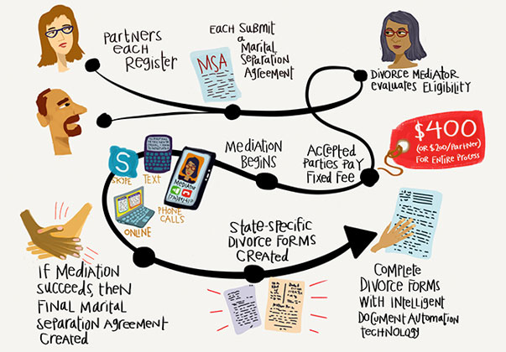
Online Mediation– when the parties are in different countries or cities, but not limited to…

Slide 15
BULGARIA
PAMB introduced
ODR in Cross Border Mediation under
Project EuroNet Mediation - 2011 / 12
www.mediation-net.eu
Conference on Cross border mediation – November, 2012

Slide 16
STAGES AND STEPS FOR CONDUCTING ONLINE MEDIATION
To be an active participant in On-line Mediation running through WebEx, you need a headset and a microphone connected to your computer.
At your email address you will receive an invitation for Online Mediation!
The invitation includes a date, an hour, a password and a link to join the system(JOIN).

Slide 17
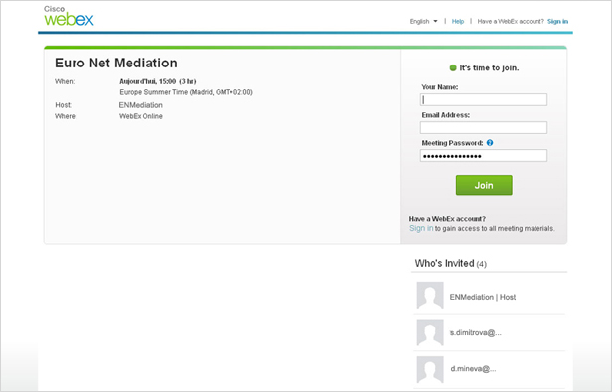
Фиг. 2
Enter your name, e-mail, and password (given in the invitation) in the fields below and click on "Join" to enter the session.

Slide 18
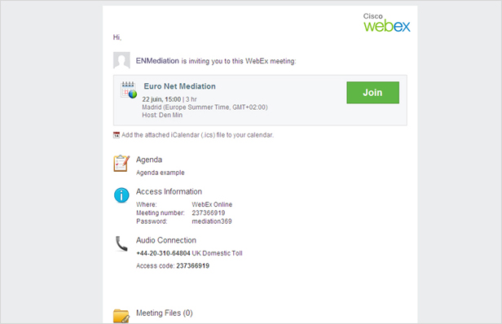
Фиг. 1
After clicking on the link from the invitation received from WebEx or webex@solytron.bg, the following window will open (Figure 2)

Slide 19
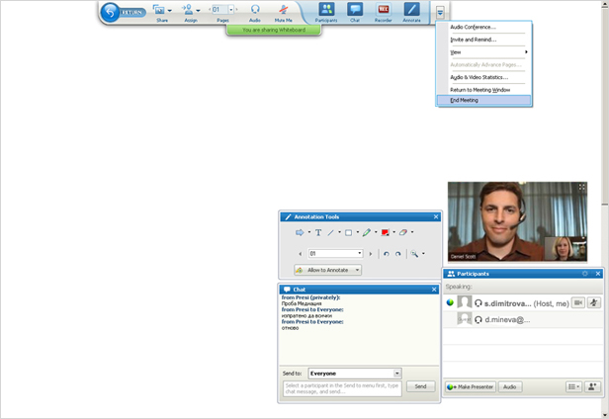
You now see a white box behind the windows - the mediator can load his desktop and display documents, presentations, and so on.

Slide 20
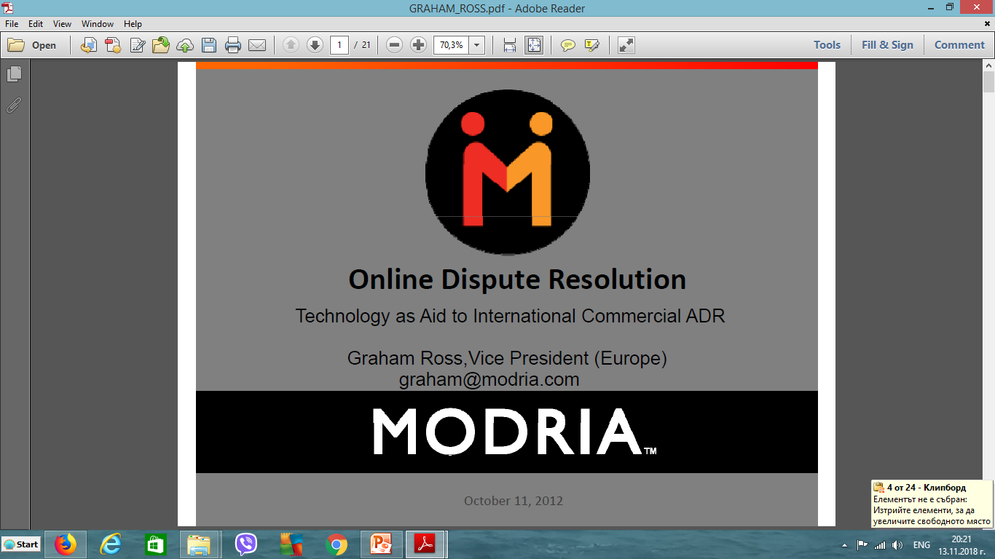

Slide 23
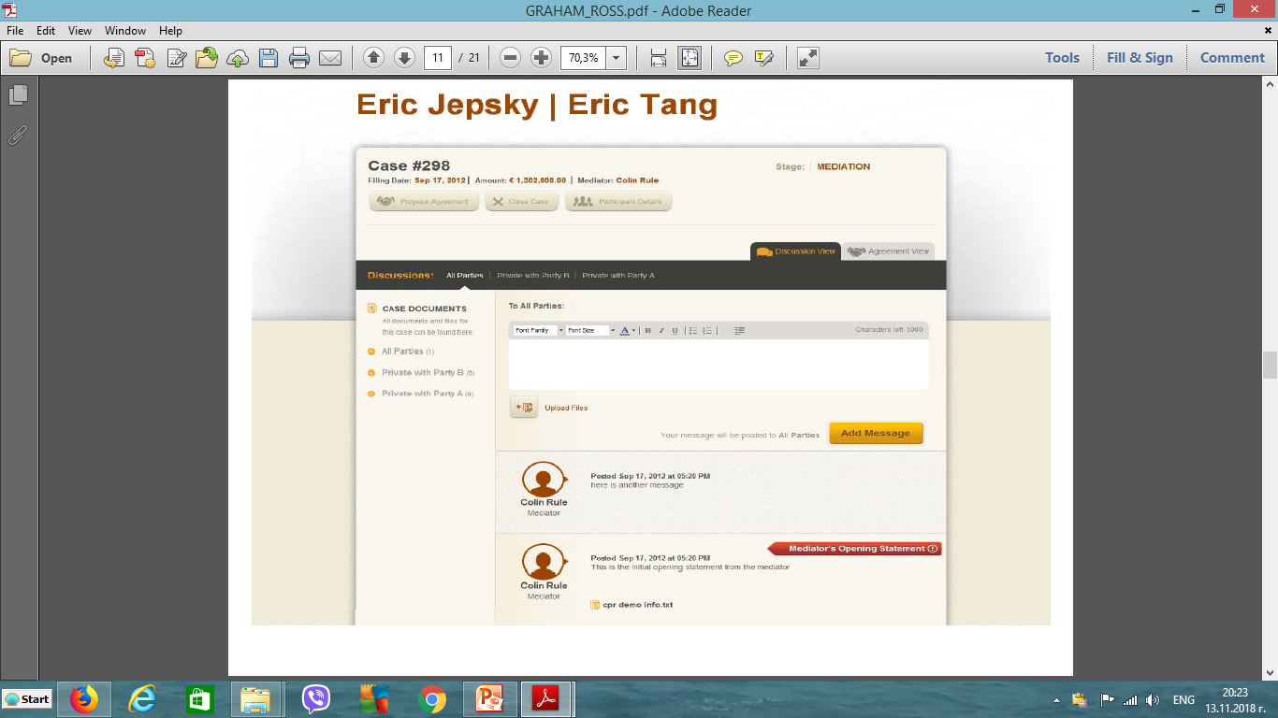

Slide 24
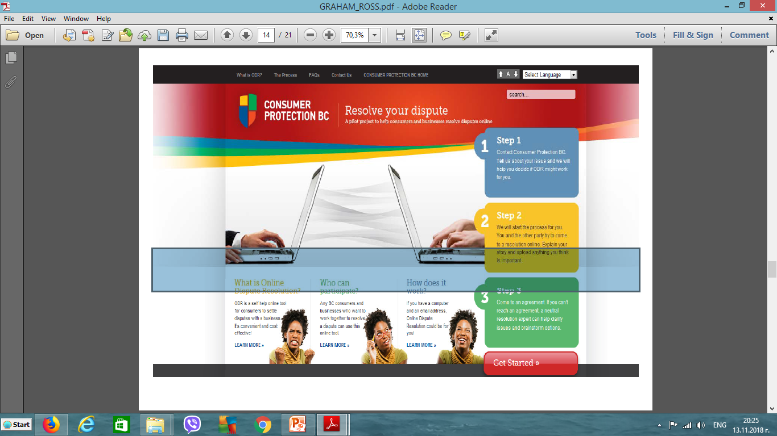

Slide 25
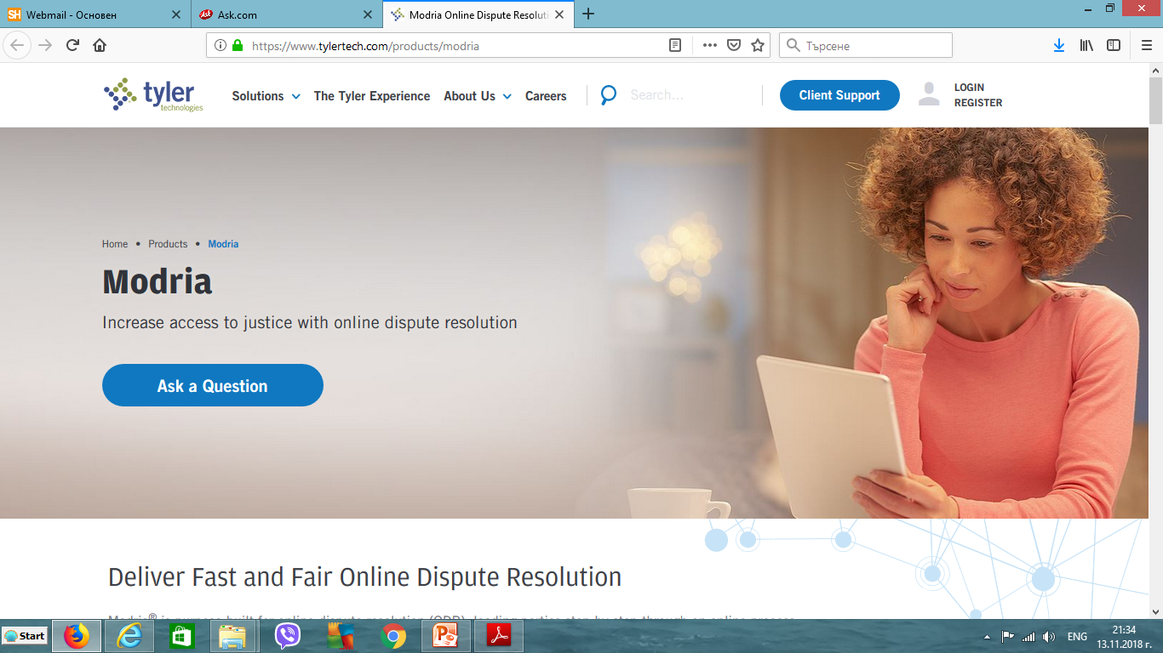

Slide 30
2016-2017
PAMB was partner in project
PROTECTING THE CHILD European conference for Family Justice Practitioners by Family Justice Practitioners to improve cooperation in cases of parental child abduction
http://elearn-childabduction.eu

Slide 31
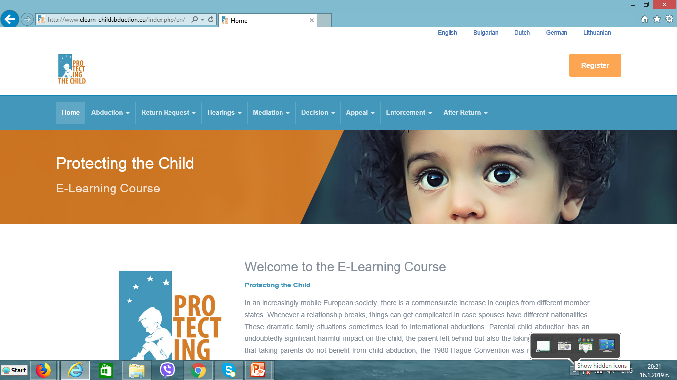

Slide 32
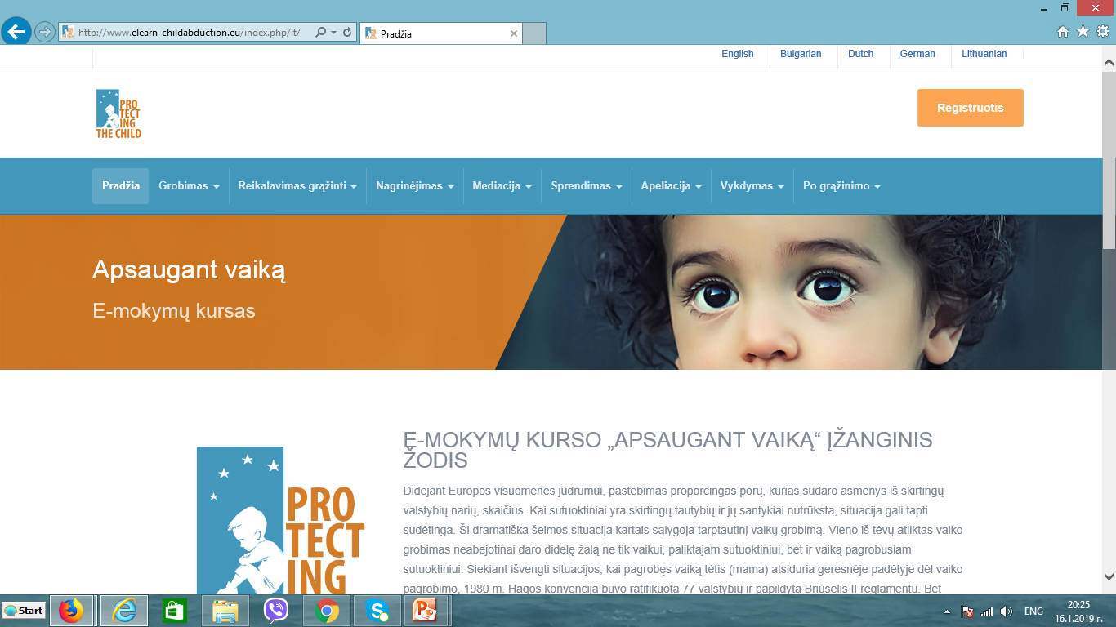

Slide 33
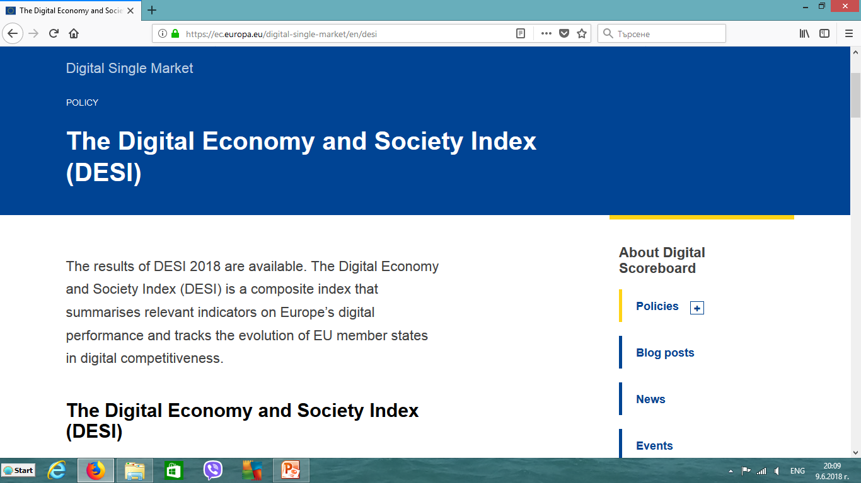

Slide 34
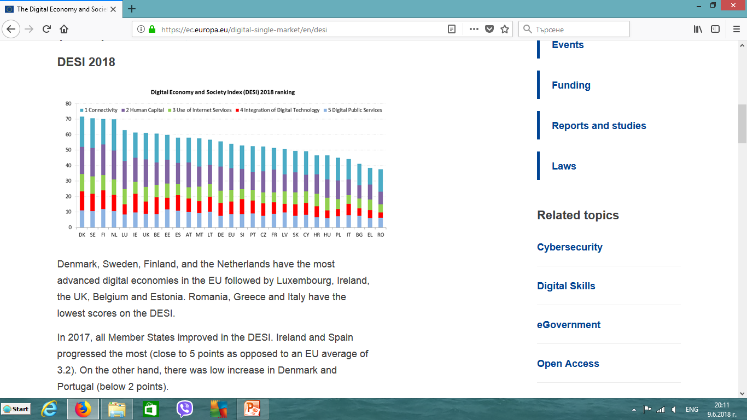

Slide 35
2013-2016
Directive 2013/11/EU of the European Parliament and of the Council of 21 May 2013 on alternative dispute resolution for consumer disputes and amending Regulation (EC) No 2006/2004 and Directive 2009/22/EC (Directive on consumer ADR) – implemented in national legislations till 9 July 2015
Regulation (EU) No 524/2013 of the European Parliament and of the Council of 21 May 2013 on online dispute resolution for consumer disputes and amending Regulation (EC) No 2006/2004 and Directive 2009/22/EC (Regulation on consumer ODR) – in force from 9 January 2016

Slide 36
2016 - National Association for out-of-court settlements www.nais.bg
2016 - Notification to the Ministry of Economy as an ADR body under Directive on consumer ADR
2017 – inclusion in the European ODR platform
https://ec.europa.eu/consumers/odr/main/index.cfm?event=main.adr.show

Slide 37
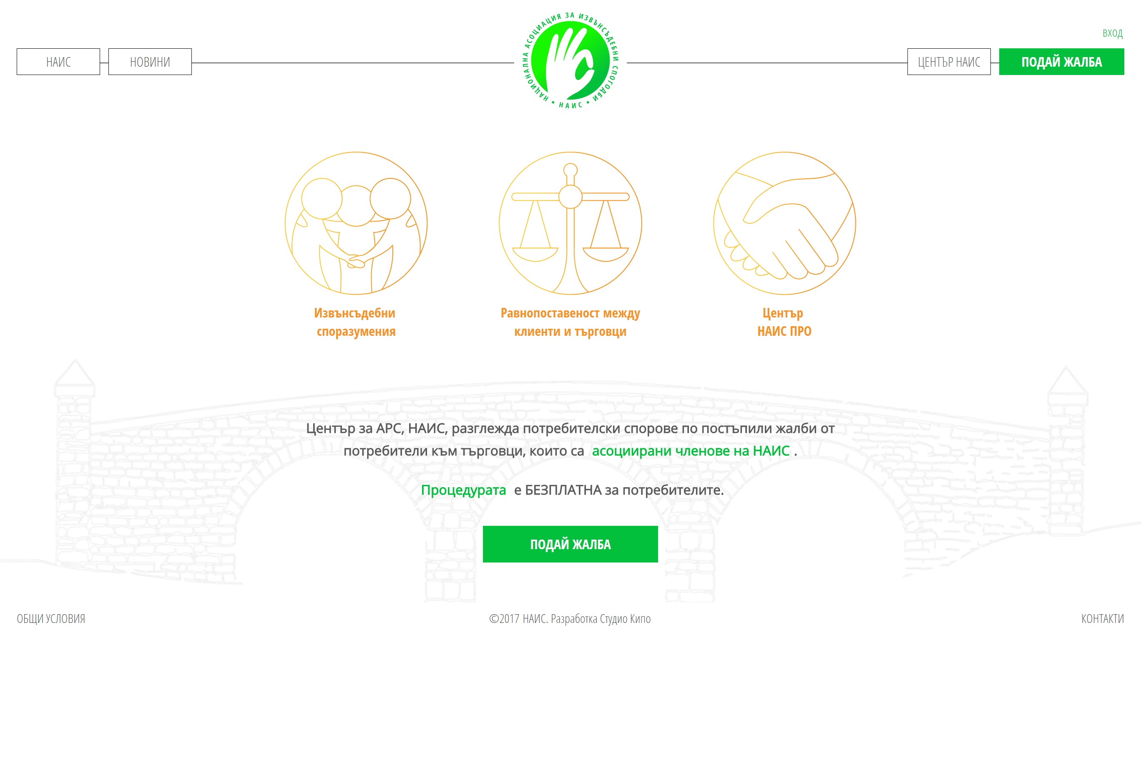
Notes:
Отговаря на най-съвременни изисквания за интуитивност, лесен път и бързо достигане до крайна цел- подаване на жалба.
Удобен обмен на инфо чрез чат и мейли.
Риспонсив модел- т.е. чете се и от мобилни устройства.

Slide 38
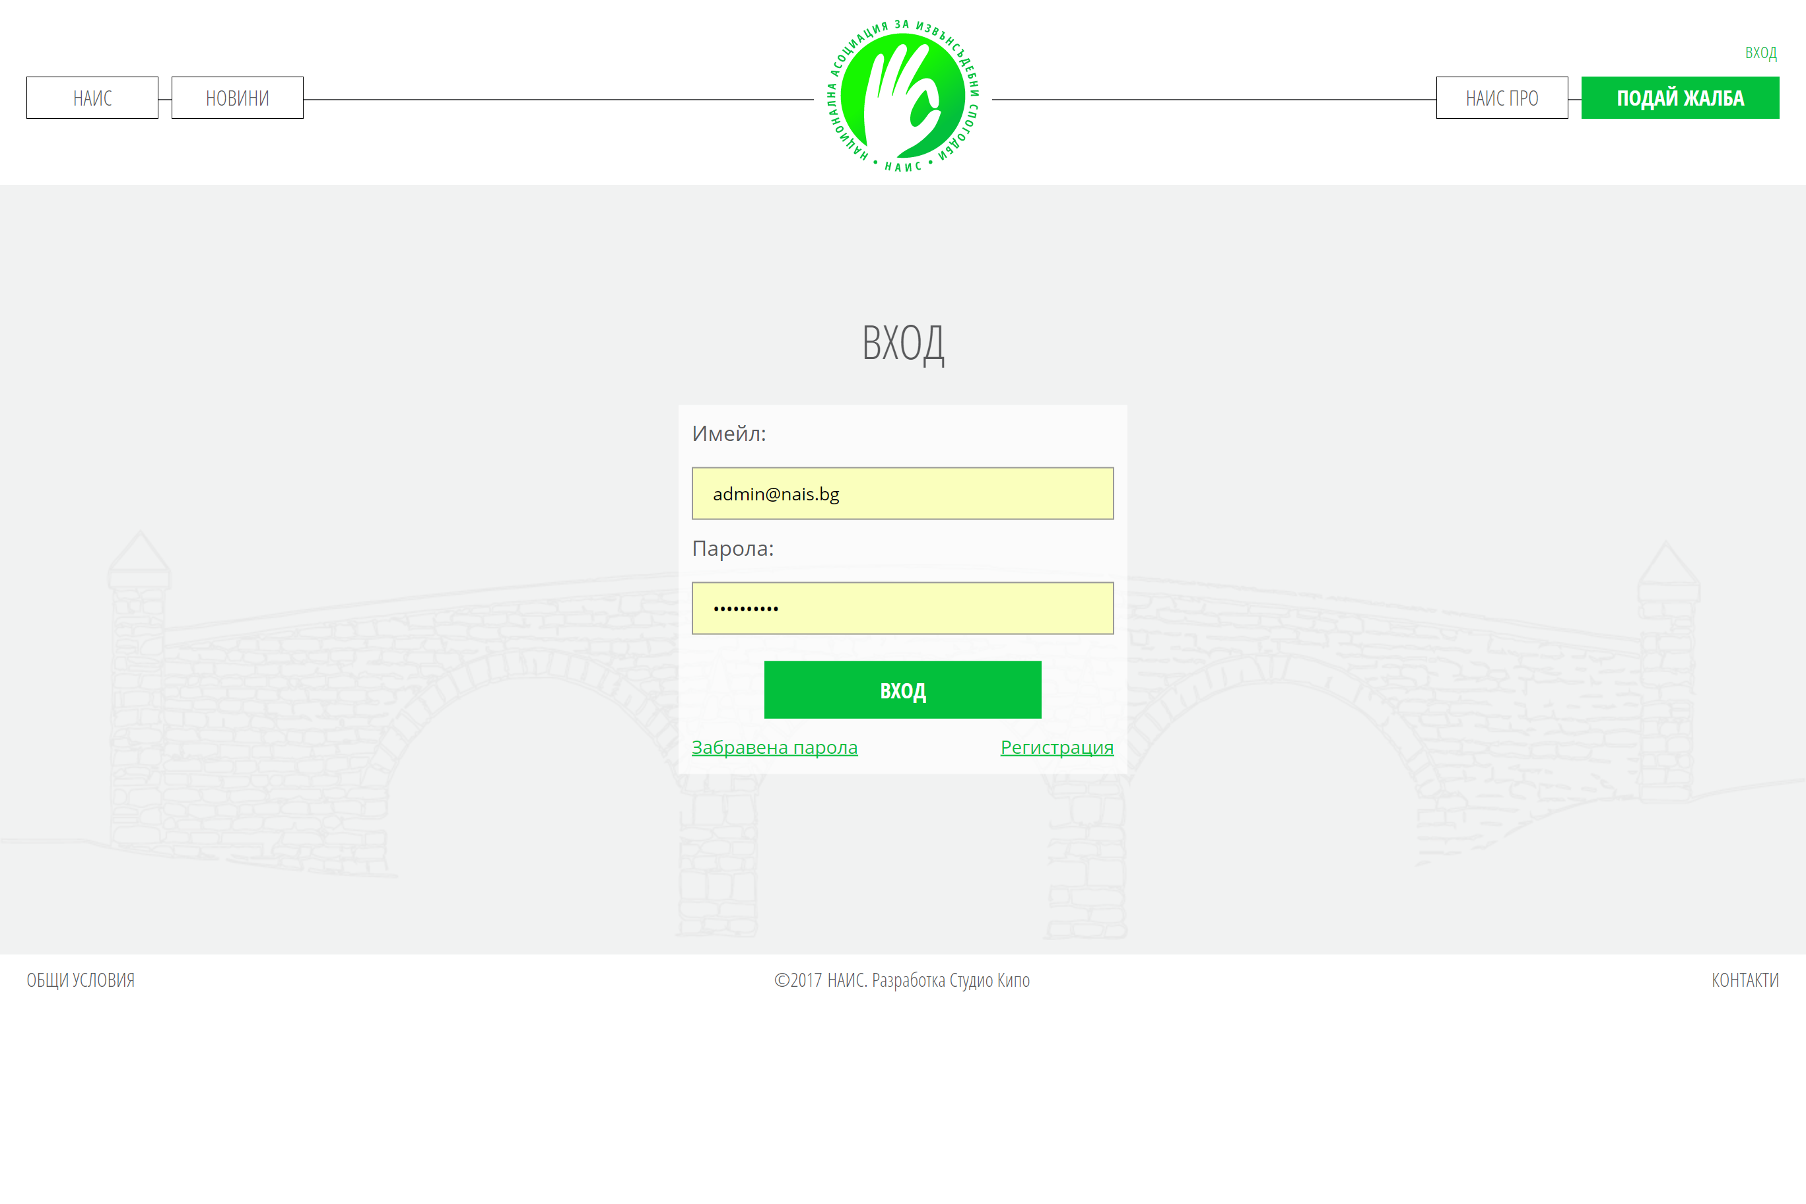

Slide 39
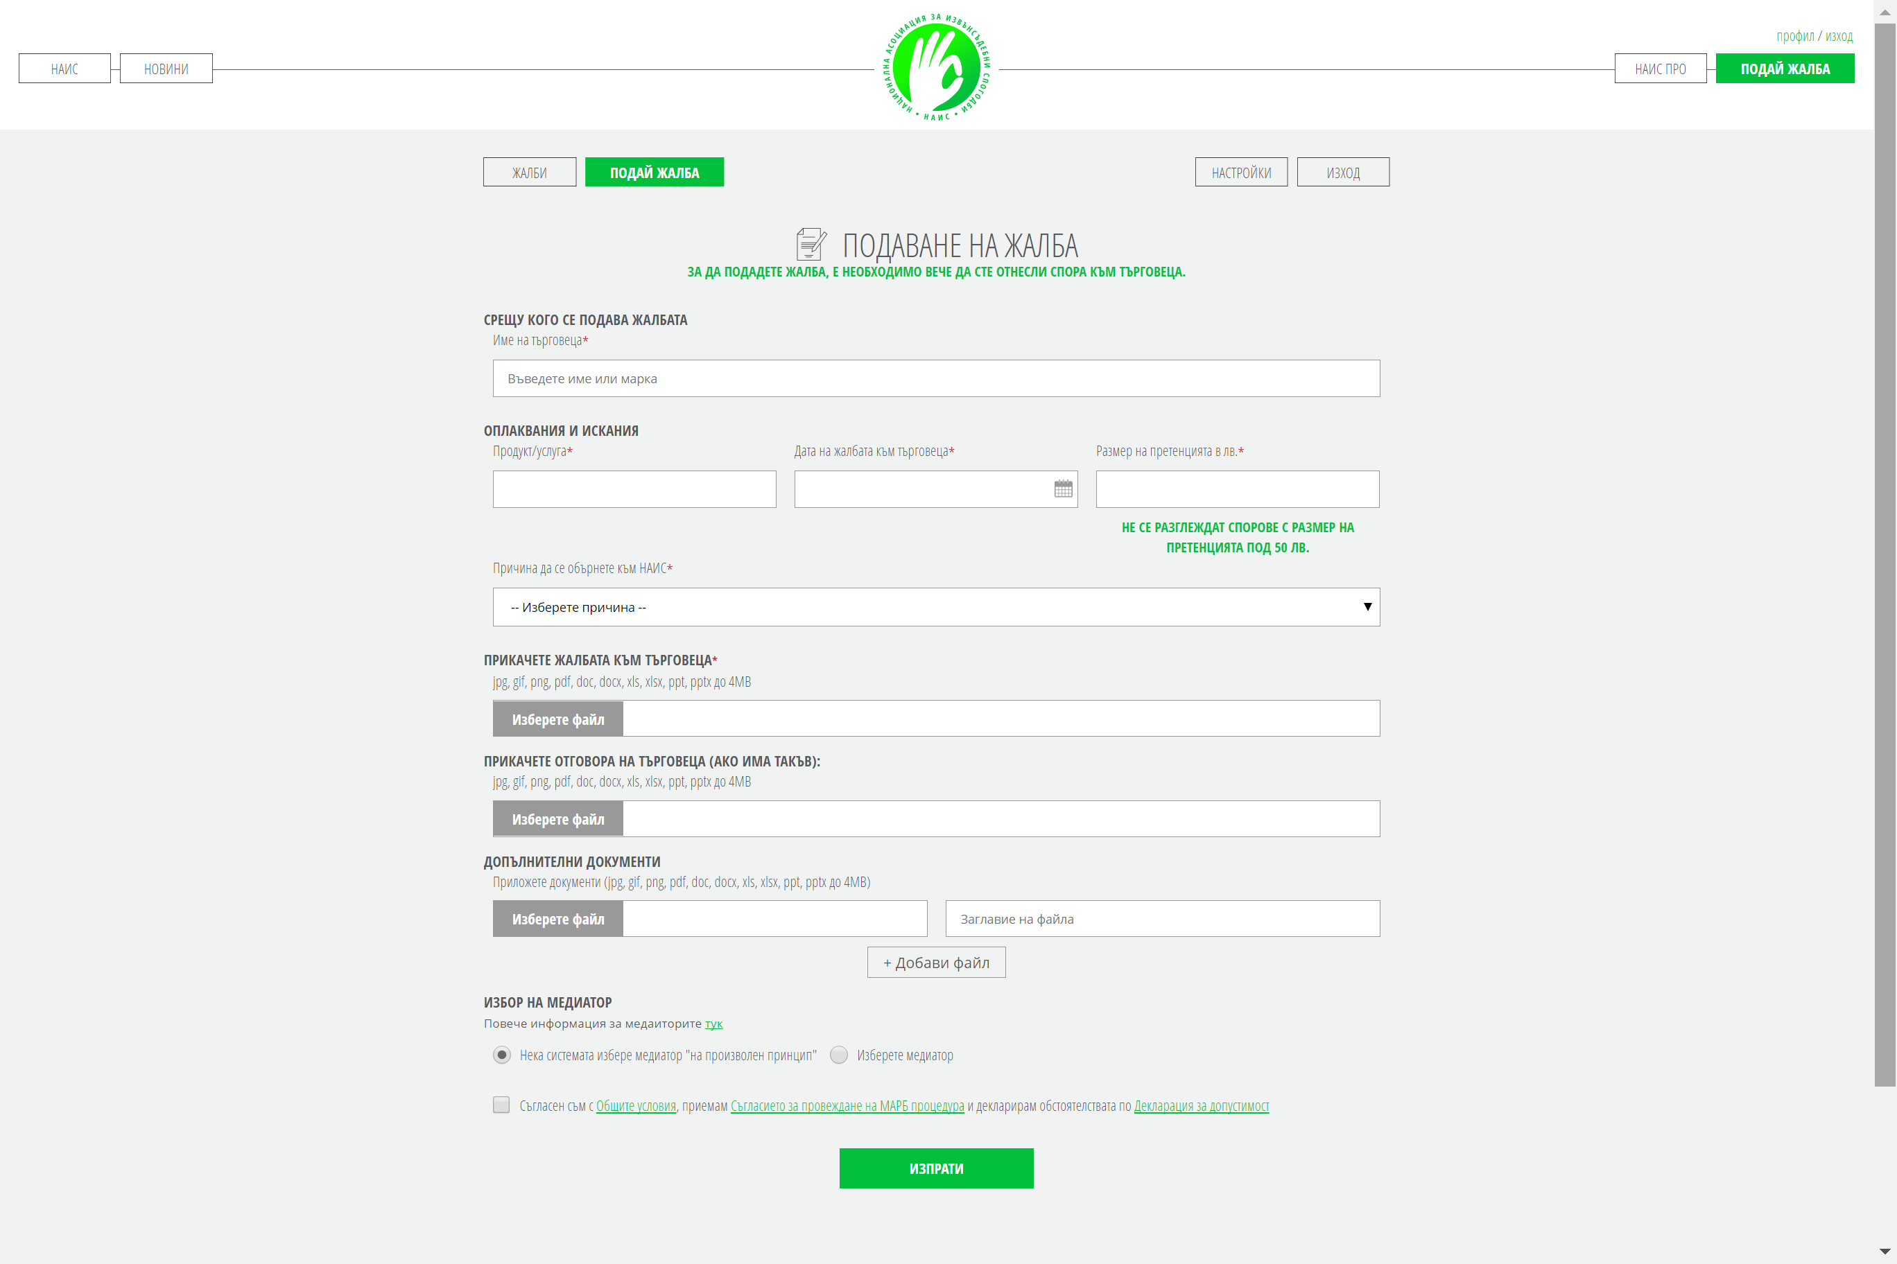
Notes:
Тук се съгласява с общите условия, с производството по медиация и че е отнесъл вече спора към търговеца , но не е удовлетворен.

Slide 40
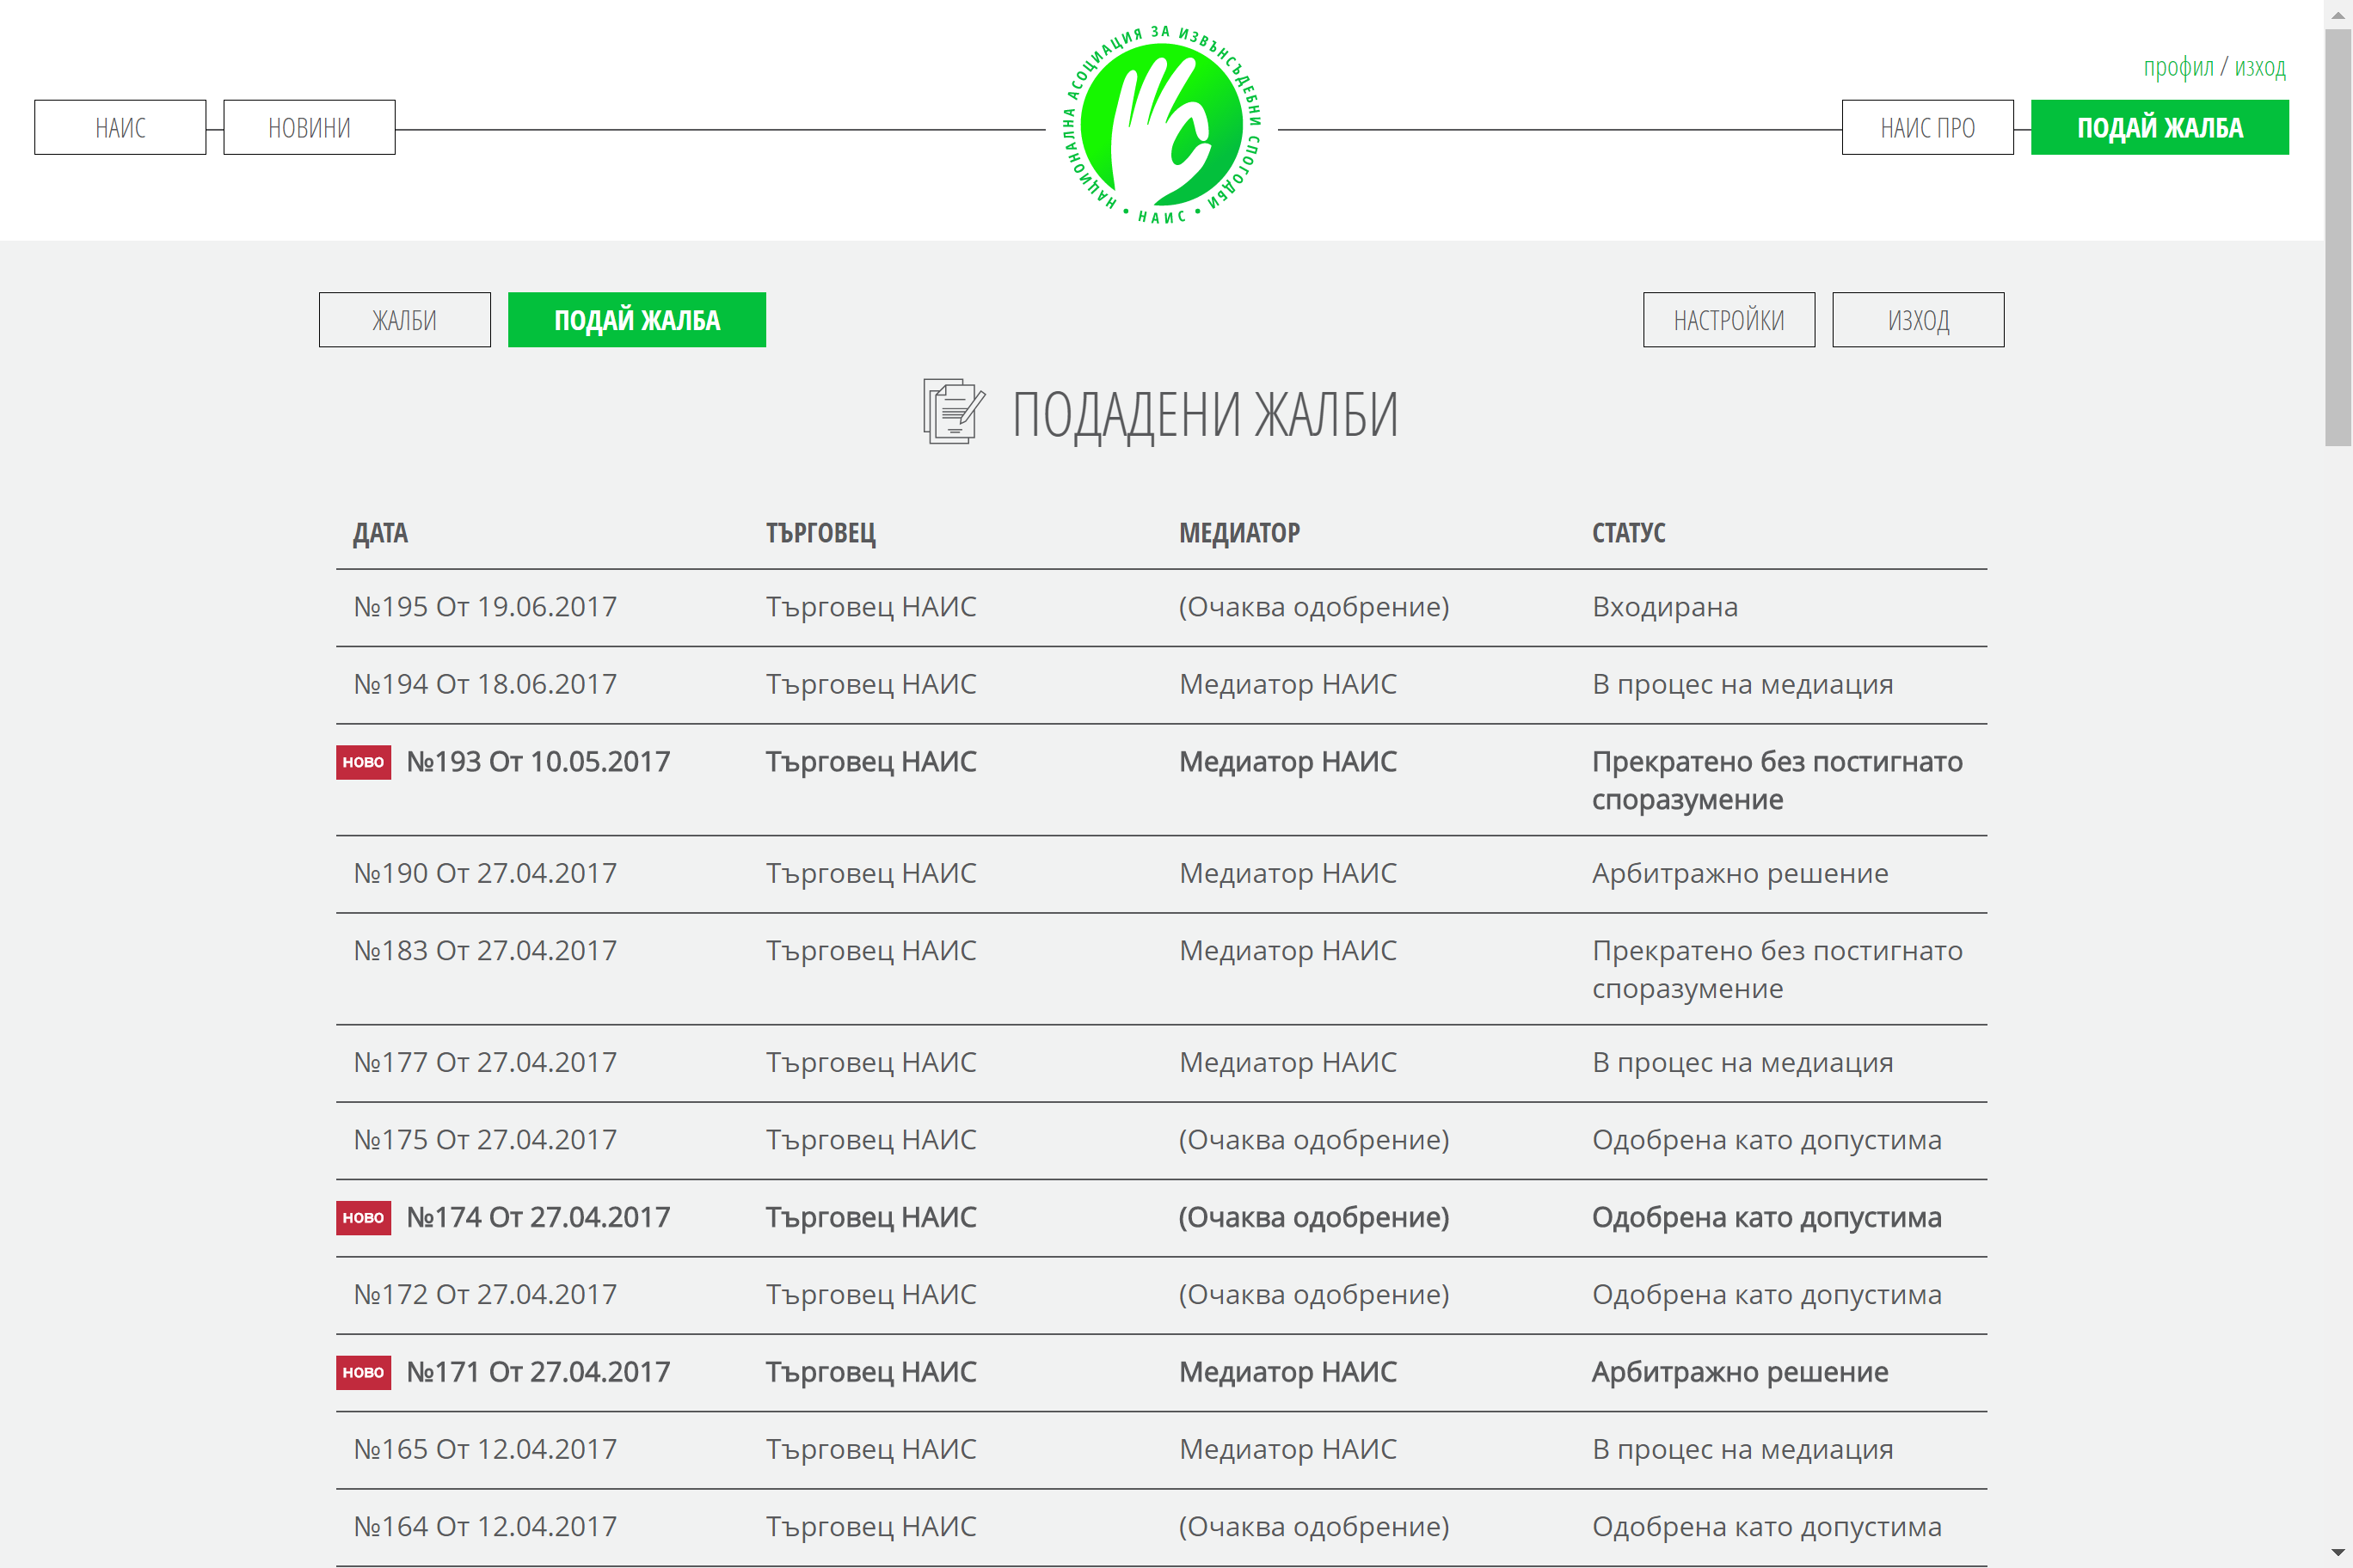

Slide 41
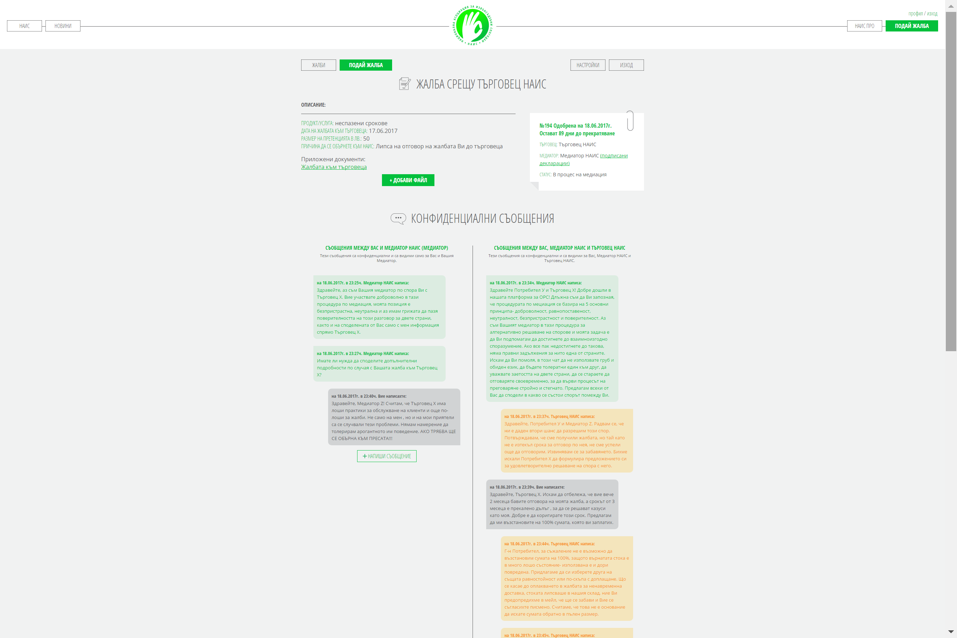
Notes:
Чат плюс качване на файлове. Личен и общ. Спазване на конфиденциалност вътрешна и външна.

Slide 42
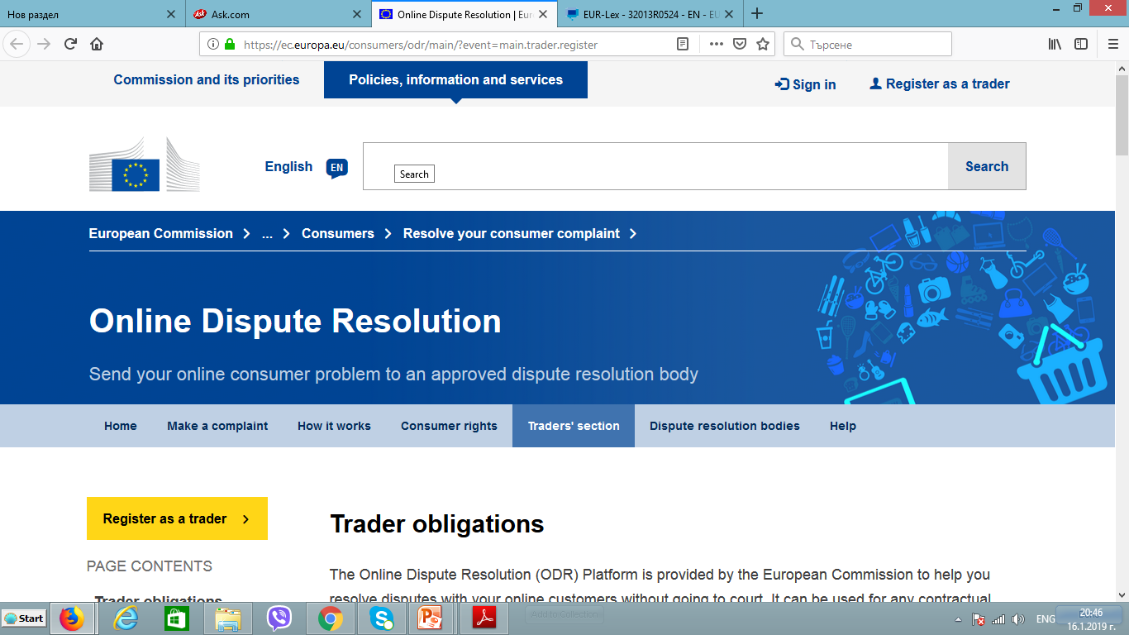
European ODR platform
https://ec.europa.eu/consumers/odr/main

Slide 43
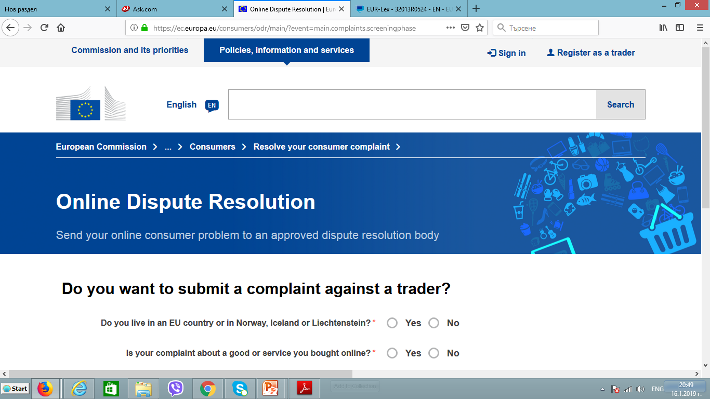

Slide 44
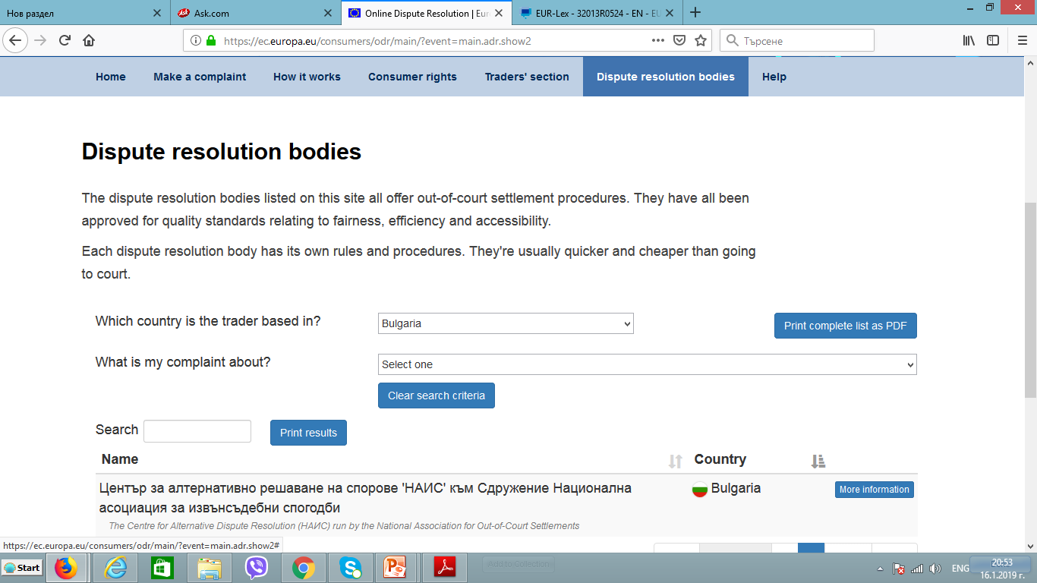

Slide 45
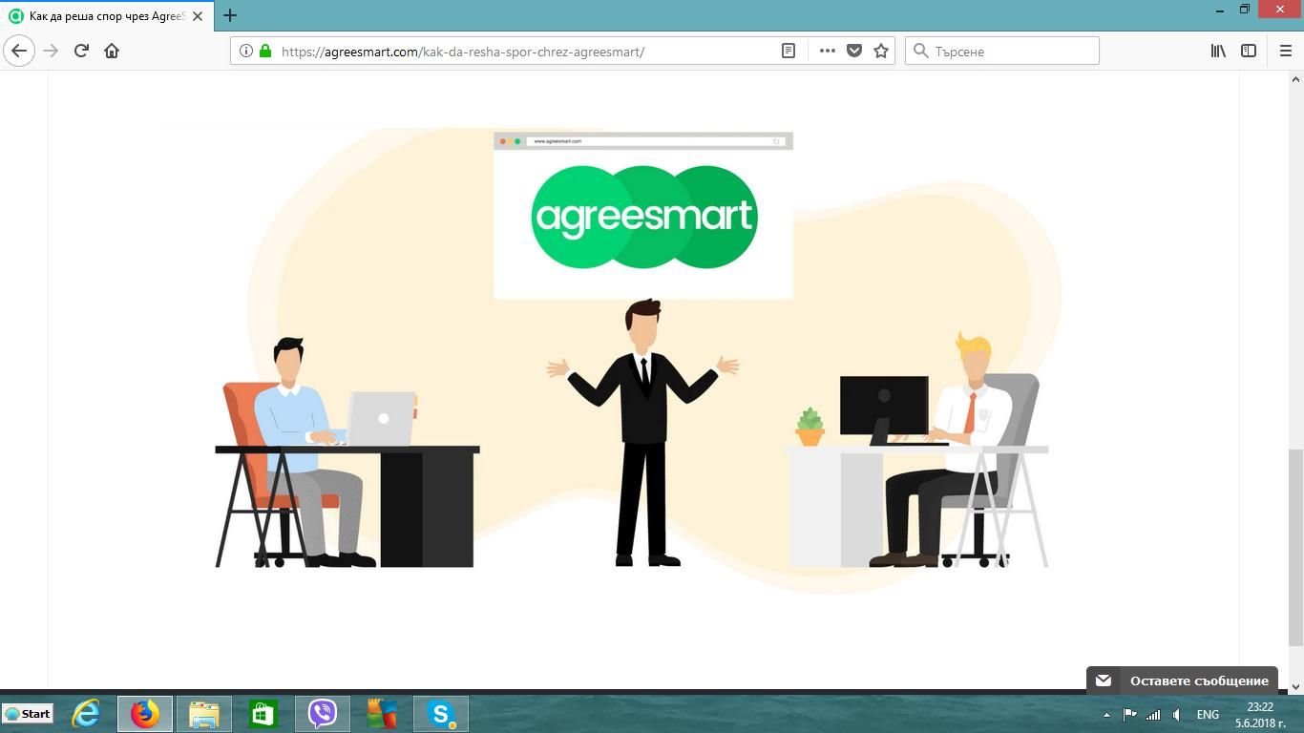

Slide 46
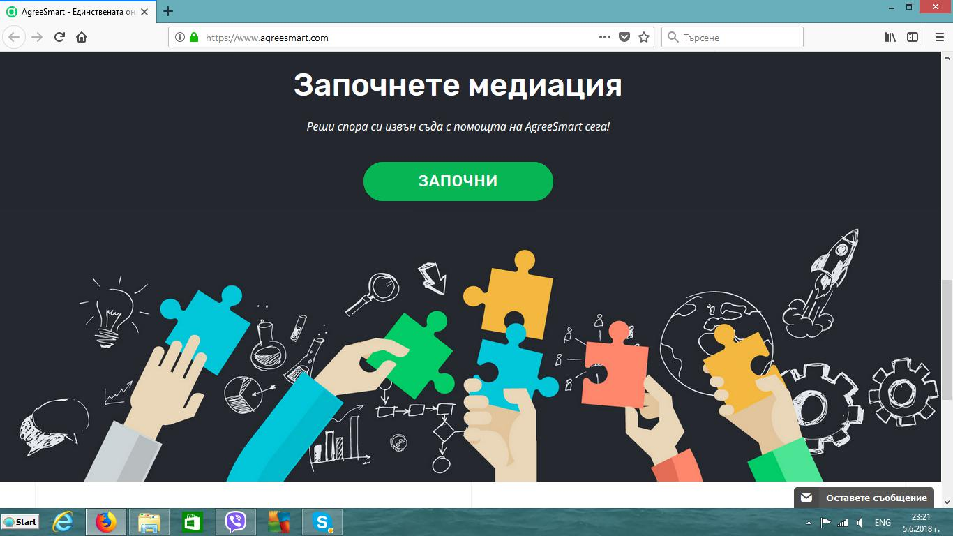

Slide 47
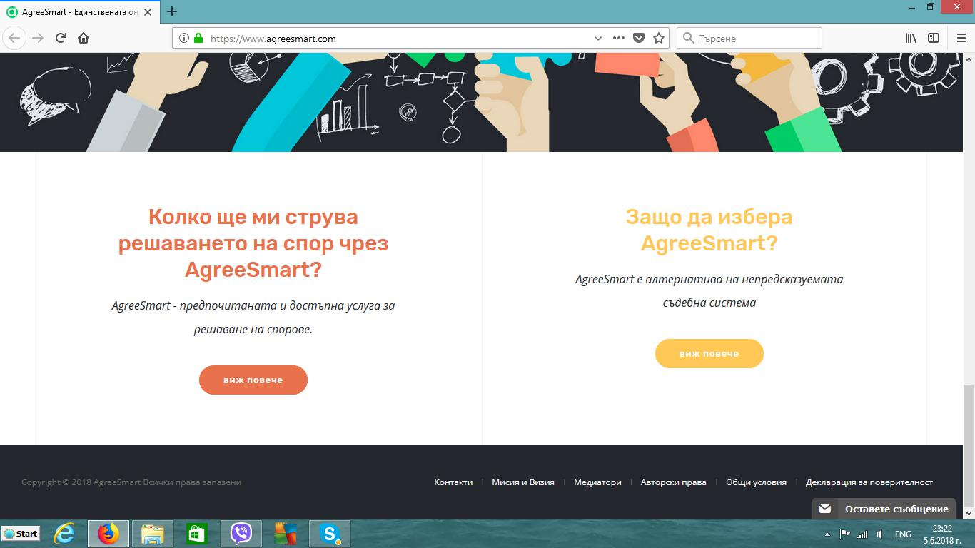

Slide 48
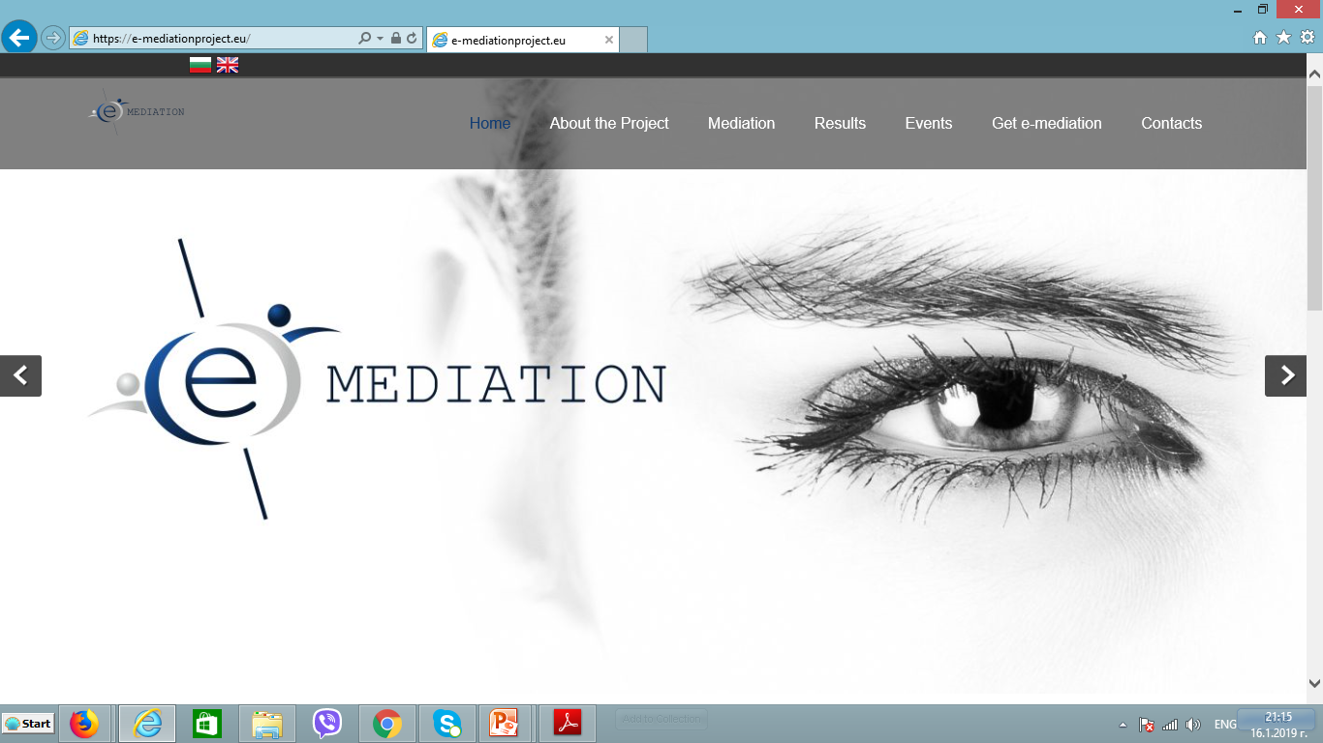

Slide 49
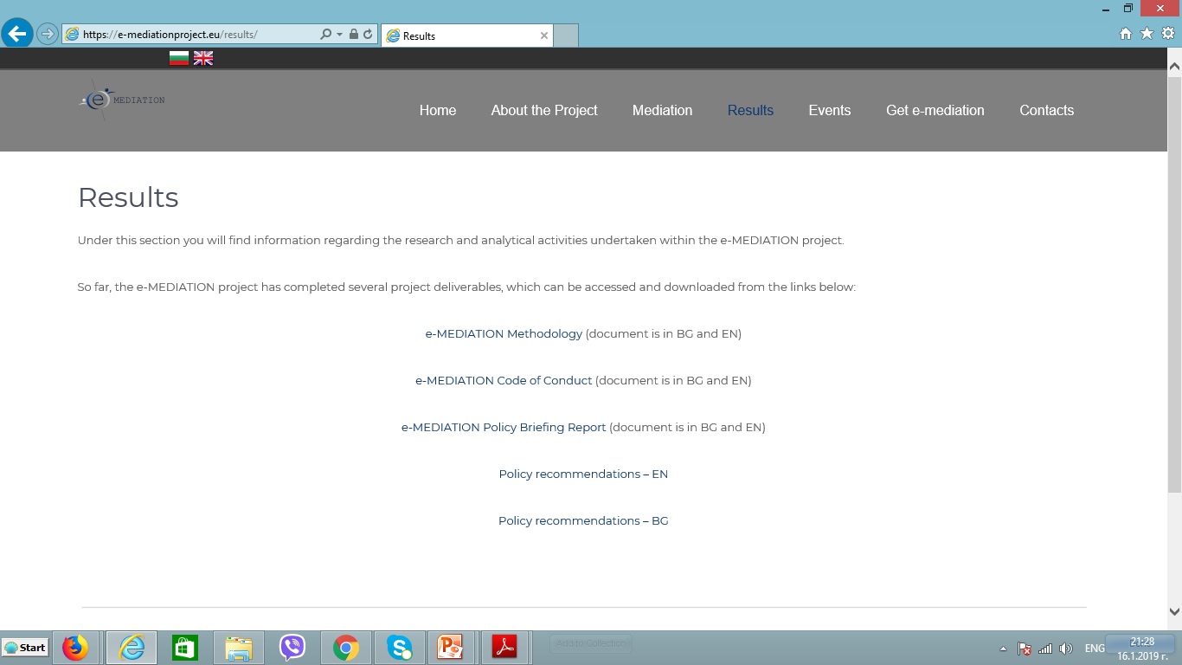

Slide 50
How to create a platform for E-mediation:
“Welcome portal”
information uploaded should be accurate and complete in order to attract more users and meet their expectations;
information should not contain any misleading or redundant information or extra burden functionalities that hinder the provision of the service;
compatibility between the website and the terminal equipment of the users –including tablets, smart phones;
website should be easy to navigate;
the information on website should be presented in a clear, short and consistent manner;
a lot of images displayed;
user-friendliness;
easy and intuitive management.

Slide 51
in 4 ODR
- rapid development of digital technologies;
- further development of social networks; - new digital communication channels; - rising levels of online commerce; - mobility of citizens; - globalization; - Artificial Intelligence? - what is next?

Slide 52
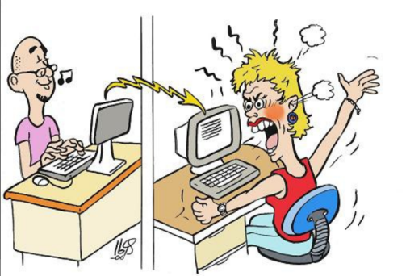
Challenges
How to apply traditional mediation techniques on-line
How to ensure confidentiality
Creating trust in on-line environment
The role of the third neutral person in on-line space
Participation of third parties
Technical equipment and technical knowledge

Slide 53
Thank you

